Slide 1
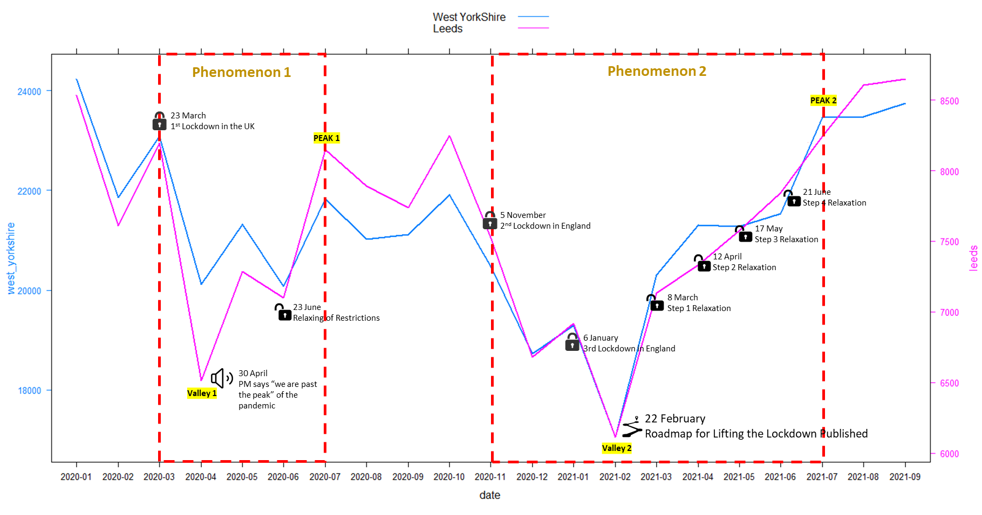
Name : Umar Fadhil Ramadhan
Student No : 201578925
Link : https://github.com/umarfadhil/Leeds_BADS_UK-WestYorshire-Police.git
Crimes in West Yorkshire During Covid-19
(Jan 20 – Sep 21)
What is the most affected criminal type during the Valleys and Peaks?
*Data Cleansed: Closed Cases, Null Crime ID Removed, Null Long-Lat Removed, Remove Duplicate Data
“Lockdown and Relaxation of Restrictions affect the number Street-Level Crimes in West Yorkshire, and it has the same pattern with Leeds”
NEXT
Sources
data.police.uk (accessed November 5th, 2021)
www.instituteforgovernment.org.uk/charts/uk-government-coronavirus-lockdowns (accessed November 7th, 2021)

Slide 2
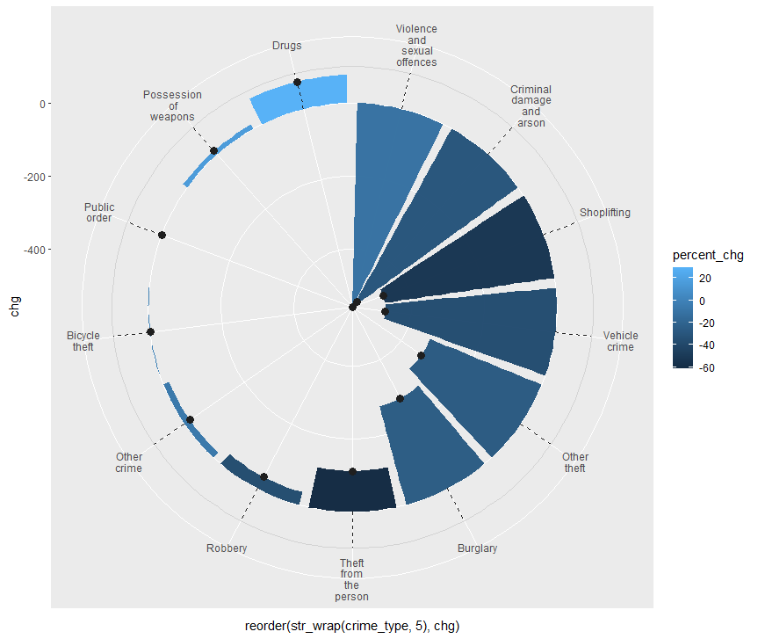
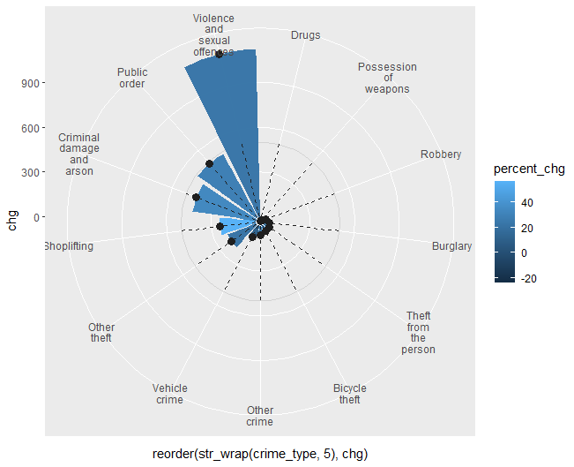



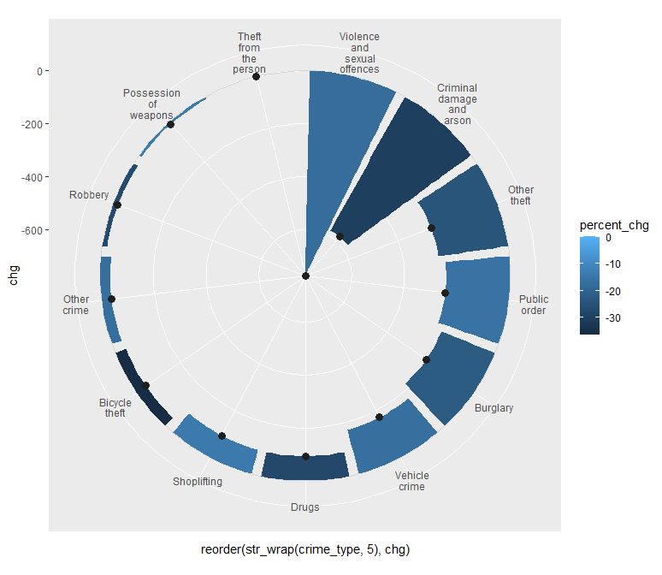
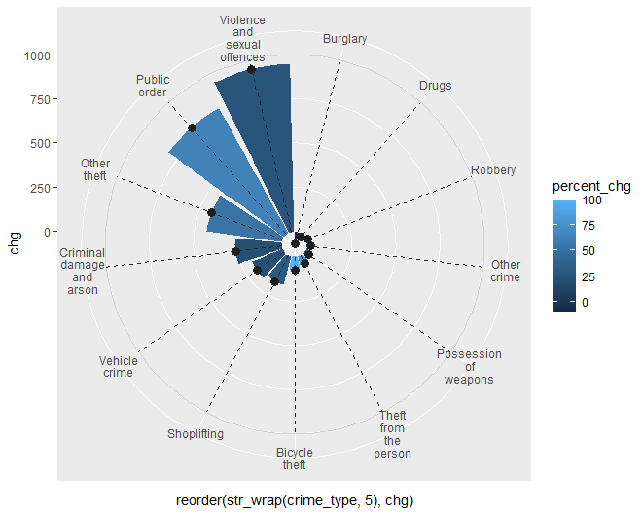
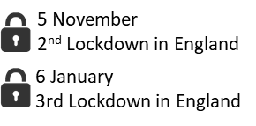


VALLEY 1
PEAK 1
Violence and Sexual Offences is the most
significant crimes type which is affected by
government restrictions by the number of
the cases.
Meanwhile, there are two more interesting
facts!
In terms of drugs, there was a raise by 30% during 1st lockdown.
Theft (Bicycle theft and Shoplifting) were the most criminal actions which have highest increase in percentage after relaxation 50% and 100% respectively.
Phenomenon 1
VALLEY 2
PEAK 2
So, where does the centre of the Violence and Sexual Offences mostly happen in peaks 1 and 2? Then how do students avoid drugs and bicycle theft?
NEXT
Phenomenon 2

Slide 3



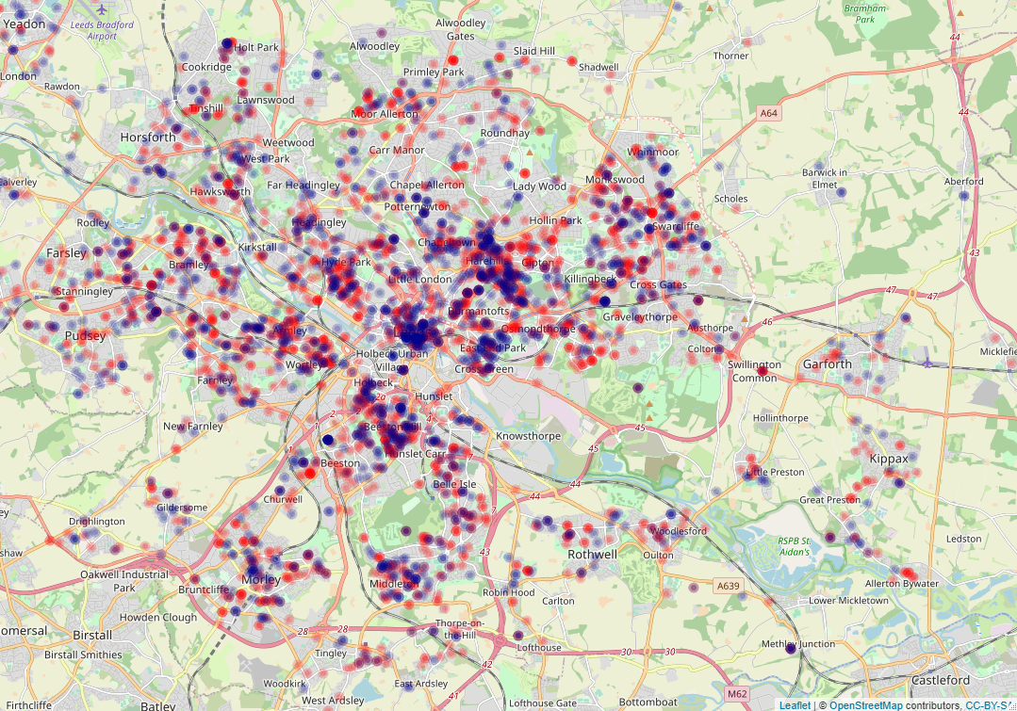
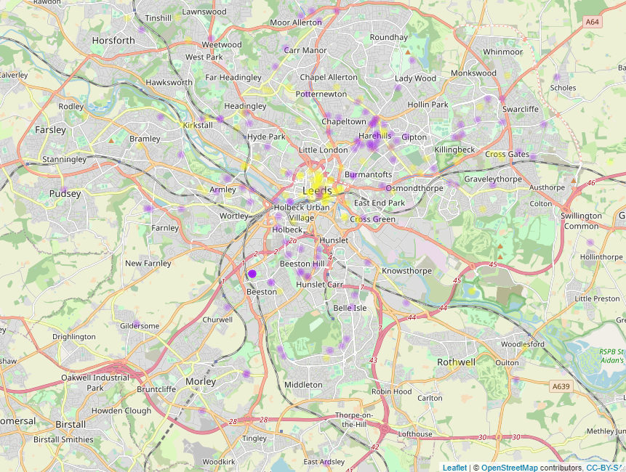
Beeston Hill
Harehills
Hyde Park
City Centre
East End Park
Beeston – Beeston Hill
City Centre
Harehills
Violence and Sex Offences in Peak 1 and 2 (after relaxation of restrictions)
Drugs in Valley 1 (during 1st Lockdown) and Bicycle Theft in Peak 2
Violence and Sex Offences in Peak 1
Bicycle Theft in Peak 2
Violence and Sex Offences in Peak 2
Drug in Valley 1

